Slide 1

SMART MEDICINE REMINDER FOR ELDERLY PEOPLE

Slide 2
PURPOSE
Sometimes elderly people forget to take the medicine at the required time of medicines. And sometimes they also forgets which medicine they have to take at required time. And it is difficult for care takers to monitor patients around the clock . To avoid this kind of situations our project is used.

Slide 3
HARDWARE COMPONENTS
NODE MCU
BUZZER
RTC MODULE

Slide 4
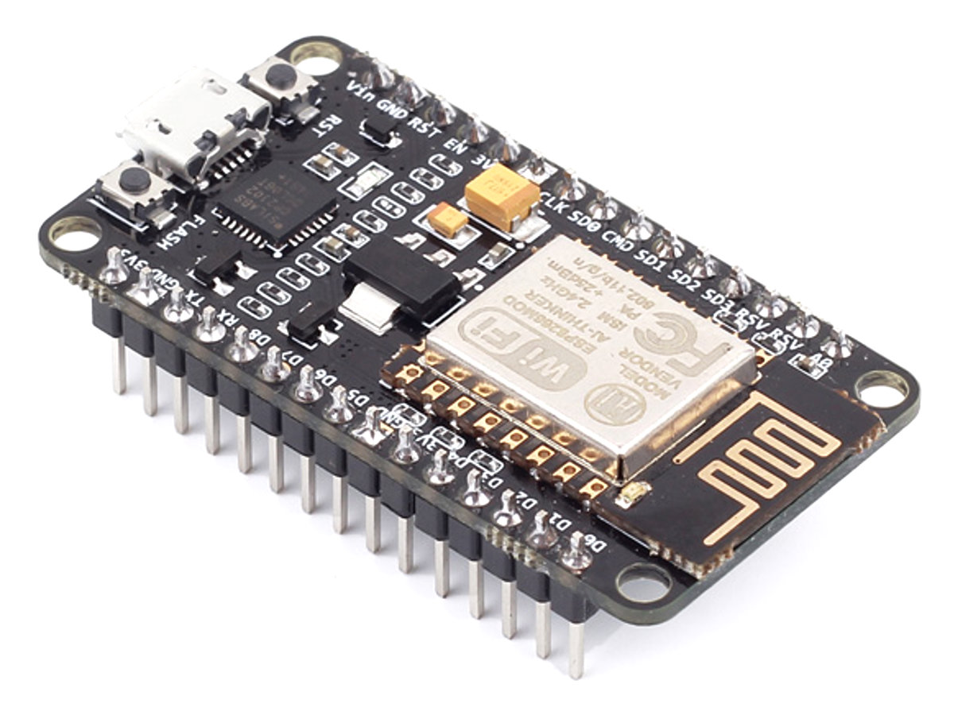
NODE MCU
Node MCU development board is an open source IOT development kit
It is a low cost hardware platform for development of IoT applications

Slide 5
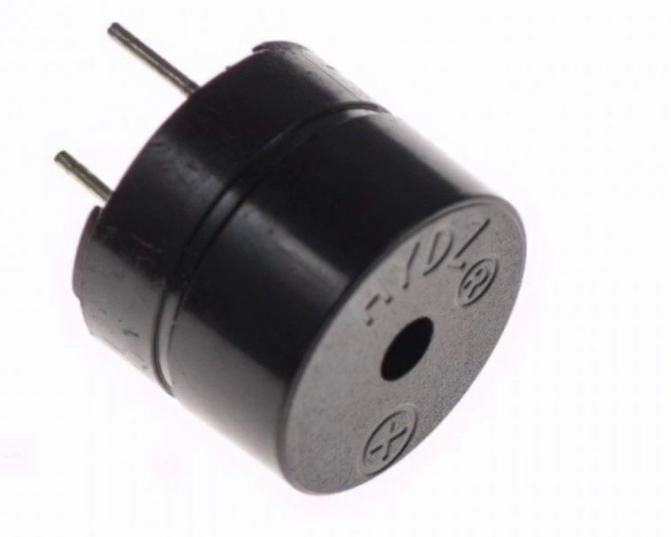
BUZZER
A buzzer or beeper is an audio signaling device, which may be mechanical, electromechanical, or piezoelectric .
Typical uses of buzzers and beepers include alarm devices, timers, and confirmation of user input such as a mouse click or keystroke

Slide 6
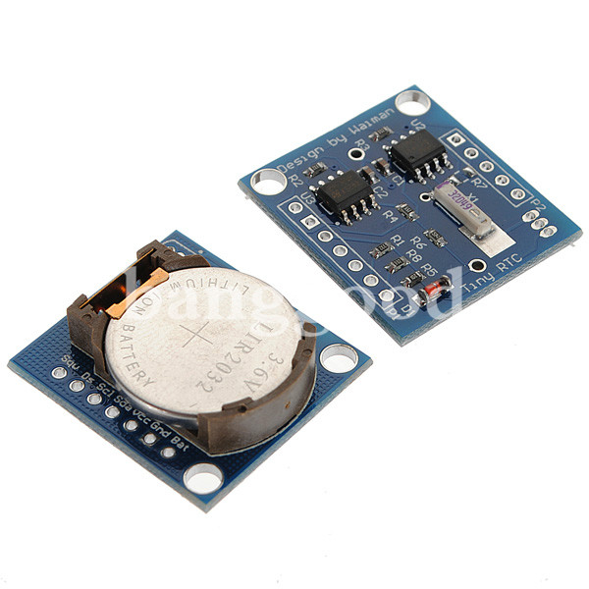
RTC DS-1307
A real-time clock (RTC) is a computer clock that keeps track of the current time which are present in almost any electronic device.
RTCs often have an alternate source of power, so they can continue to keep time while the primary source of power is off.
The alternate power source can also supply power to battery backed RAM

Slide 7
How it is used?
An app is build for the user which enables him to set the time at which the person has to consume the tablet. The time that is set is received by the RTC Module for comparison of time set by the user . If both gets matched a sound is generated by the buzzer.

Slide 8
PROJECT high LIGHTS:
Storing the medicine taking time in EEPROM.
Checking the time set by the user using RTC.
Buzzer as soon as the medicine taking time arrives.

Slide 9
CODE:
#include <Wire.h>
#include <RtcDS3231.h>
#include <ESP8266WiFi.h>
//#include <ESP8266WebServer.h>
#include <PubSubClient.h>
RtcDS3231<TwoWire> Rtc(Wire);
const char* ssid = "moto e5 plus 1371";
const char* password = "12345678";
#define ORG "56fc1a"
#define DEVICE_TYPE "newdevice"
#define DEVICE_ID "new"
#define TOKEN "123456789"
char server[] = ORG ".messaging.internetofthings.ibmcloud.com";
char topic[] = "iot-2/evt/sensorData/fmt/json";
char authMethod[] = "use-token-auth";
char token[] = TOKEN;
char clientId[] = "d:" ORG ":" DEVICE_TYPE ":" DEVICE_ID;
WiFiClient wifiClient;
PubSubClient client(server, 1883,wifiClient);
int hh=0,mm=0;

Slide 10
void setup ()
{
int frequency=1000; //Specified in Hz
int buzzPin=D5;
int timeOn=1000; //specified in milliseconds
int timeOff=1000; //specified in millisecods
Serial.begin(115200);
Rtc.Begin();
RtcDateTime compiled = RtcDateTime(__DATE__, __TIME__);
if (!Rtc.IsDateTimeValid())
{
Serial.println("RTC lost confidence in the DateTime!");
Rtc.SetDateTime(compiled);
}RtcDateTime now = Rtc.GetDateTime();
Rtc.Enable32kHzPin(false);
Rtc.SetSquareWavePin(DS3231SquareWavePin_ModeNone);
Serial.print("Connecting to ");
Serial.print(ssid);
WiFi.begin(ssid, password); //Connect to the WiFi network
while (WiFi.status() != WL_CONNECTED) { //Wait for connection
delay(500);
Serial.println("Waiting to c

Slide 11
Serial.println("Waiting to connect...");
}
Serial.println("");
Serial.print("IP address: ");
Serial.println(WiFi.localIP()); //Print the local IP
//server.on("/", handle_index);
//server.begin(); //Start the server
}
void loop ()
{
//server.handleClient(); //Handling of incoming requests
RtcDateTime now = Rtc.GetDateTime();
//Print RTC time to Serial Monitor
noTone(D5);
delay(3000);
tone(D5,4000);
Serial.print("Date:");
Serial.println(now.Day(), DEC);
int a = now.Year();
Serial.print(a);
Serial.print('/');
Serial.print(now.Month(), DEC);
int b = now.Month();
Serial.pr

Slide 12
Serial.print(b);
Serial.print('/');
Serial.print(now.Year(), DEC);
int c = now.Day();
Serial.print(c);
Serial.print(" Time:");
Serial.print(now.Hour(), DEC);
int d = now.Hour();
Serial.print(d);
Serial.print(':');
Serial.print(now.Minute(), DEC);
int e = now.Minute();
Serial.print(e);
Serial.print(':');
Serial.print(now.Second(), DEC);
int f = now.Second();
Serial.print(f);
delay(1000); // one second
PublishData(a,b,c,d,e,f);
delay(1000);
}

Slide 13
//void handle_index() {
// server.send(200, "text/plain", "This is an index page.");
//}
void PublishData(int a, int b, int c, int d, int e, int f){
if (!!!client.connected()) {
Serial.print("Reconnecting client to ");
Serial.println(server);
while (!!!client.connect(clientId, authMethod, token)) {
Serial.print(".");
delay(500);
}

Slide 14
Serial.println();
}
String payload = "{\"d\":{\"Date\":";
payload += a;
payload +="/";
payload += b;
payload +="/";
payload += c;
payload +="," "\"hours\":";
payload += d;
payload +=",” “\”min\”:”;
payload += e;
payload += "}}";
Serial.print("Sending payload: ");
Serial.println(payload);
if (client.publish(topic, (char*) payload.c_str())) {
Serial.println("Publish ok");
} else {
Serial.println("Publish failed”);

Slide 15
CONCLUSION:
The goal of our project is to provide healthy and tension free life to those users who are taking regularly pills and to provide this product at affordable cost also.

Slide 16
THANK YOU
FUTURE MINDS
1.M.Likhitha.
2.N.Namratha.
3.N.Syamdilya.

